Slide 1
ANALYZING COVID-19 DATA USING PYTHON FOR DATA DOWNLOAD AND LOADING TO A POSTGRESQL DATABASE FOR ANALYSIS & INSIGHTS
10Alytics DATA ENGINEERING
CAPSTONE PROJECTS
Presented by
Andy Olisaemeka IKEDIASHI (COHORT 23-04)

Slide 2
I established a database named 'covid_19_data' and created a table within it also named 'covid_19_data' to house the dataset. Then, I devised a concise Python script to download the 'Covid_19_data.csv' file via the link provided namely: https://drive.google.com/file/d/1SzmRIwlpL5PrFuaUe_1TAcMV0HYHMD_b/view I also employed this script to upload the data into the PostgreSQL table created previously. I constructed relevant SQL queries to dissect and uncover insights from the data in addition to the following: a. Retrieve the cumulative counts of confirmed, deceased, and recovered cases. b. Extract the aggregate counts of confirmed, deceased, and recovered cases for the first quarter of each observation year.
ANALYZING COVID-19 DATA USING PYTHON FOR DATA DOWNLOAD AND LOADING TO A POSTGRESQL DATABASE FOR ANALYSIS & INSIGHTS

Slide 3
c. Formulate a comprehensive summary encompassing the following for each country: Total confirmed cases Total deaths Total recoveries d. Determine the percentage increase in the number of death cases from 2019 to 2020. e. Compile data for the top 5 countries with the highest confirmed cases. f. Calculate the net change (increase or decrease) in confirmed cases on a monthly basis over the two-year period.

Slide 4
Other insights derivable from the dataset
1. Yearly Average Cases, Recoveries and Deaths:
2. Quarterly Average Cases, Recoveries and Deaths:
3. Total number of Cases, Deaths, and Recoveries by Country
4. Total number of Cases, Deaths, and Recoveries in the dataset
5. Top 10 Countries with the highest cases
6. Death-rate by Country
7. Countries with the Highest Recovery Rates:
8. Monthly Average Cases, Recoveries and Deaths:

Slide 5
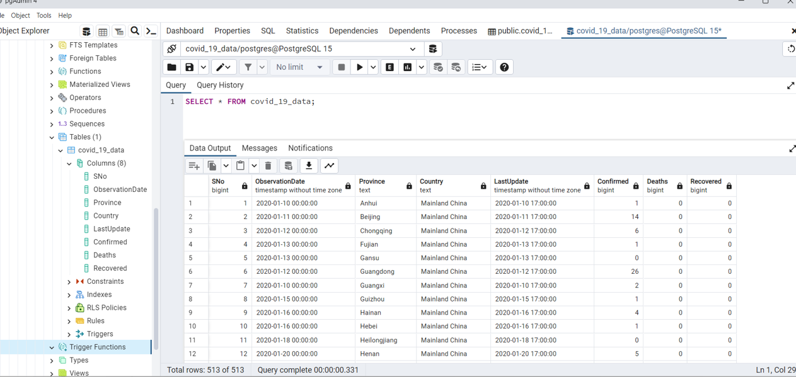

Slide 6
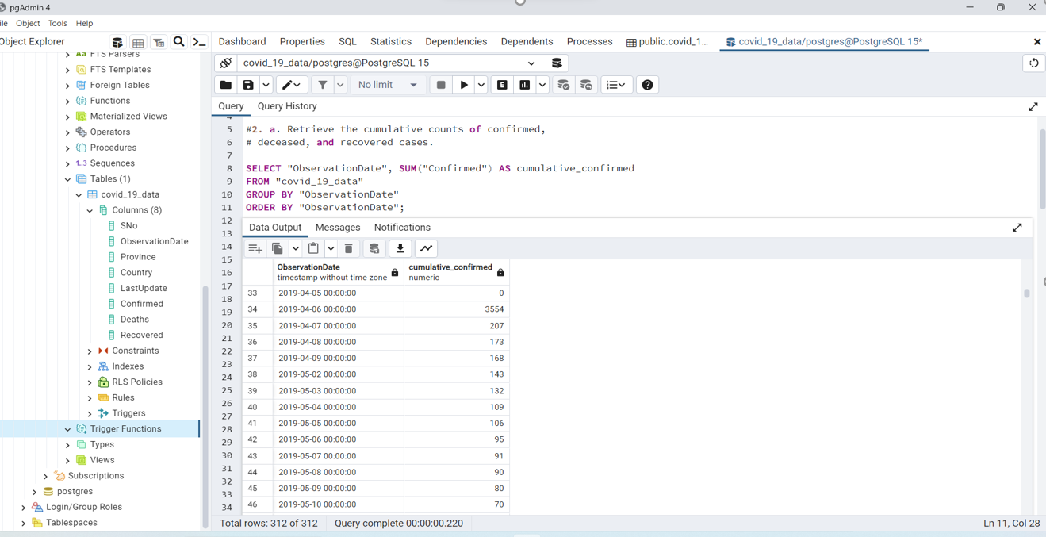

Slide 7
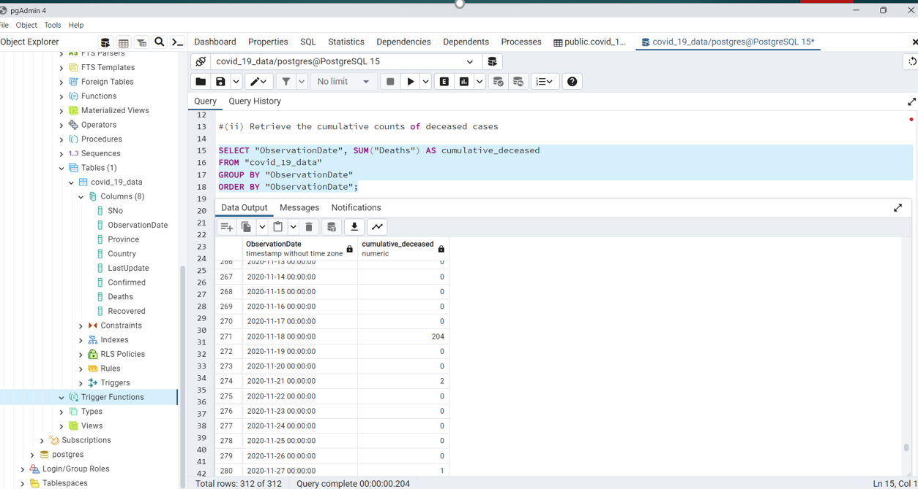

Slide 8
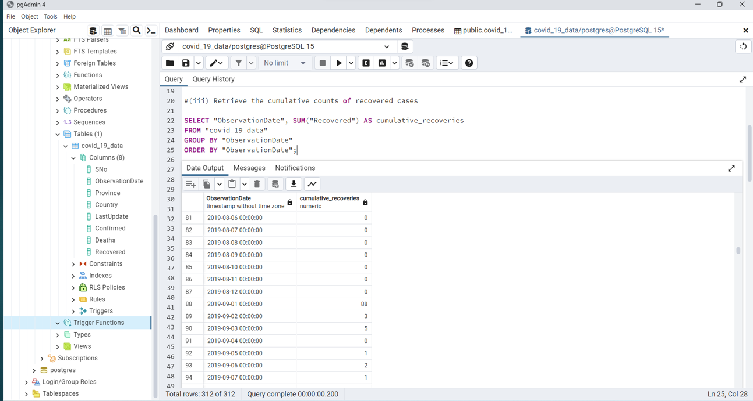

Slide 9
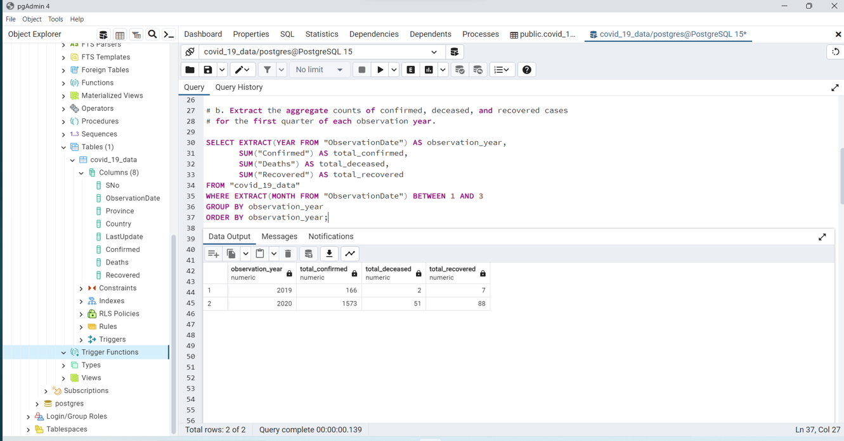

Slide 10
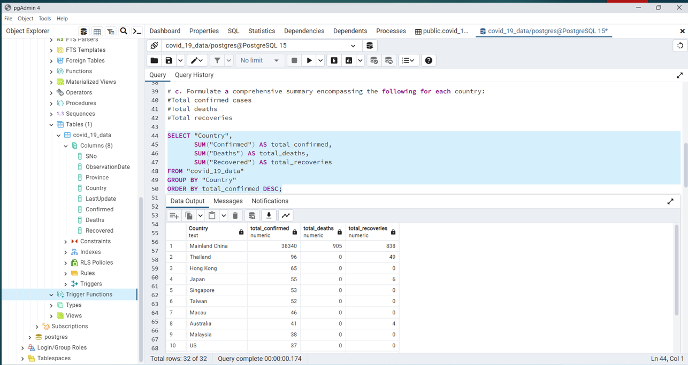

Slide 11
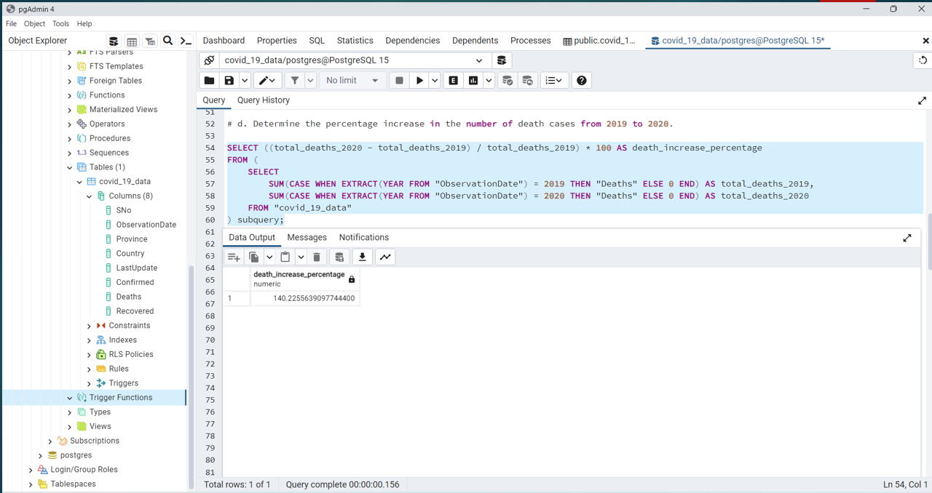

Slide 12
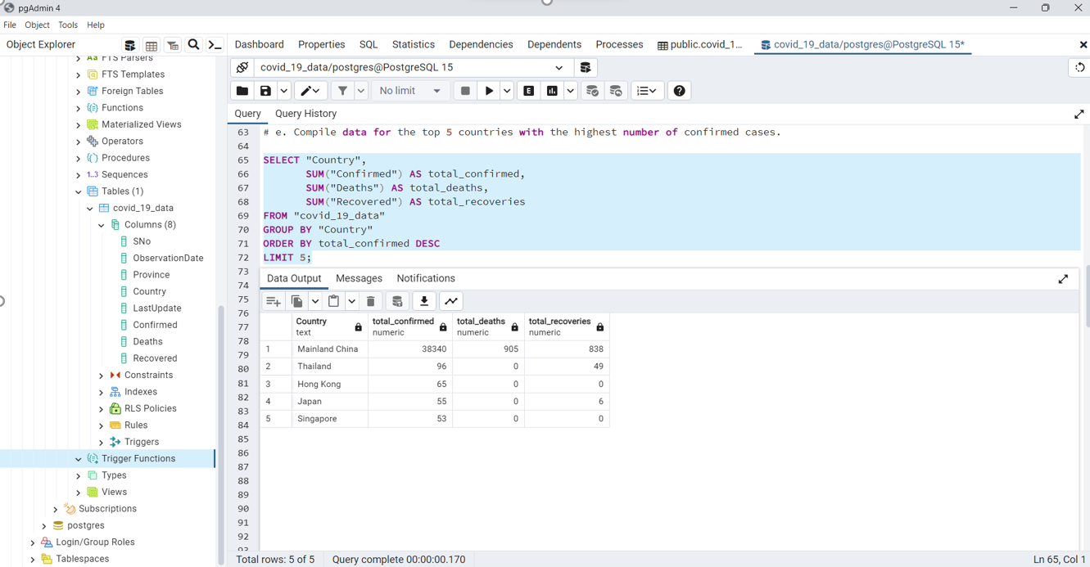

Slide 13
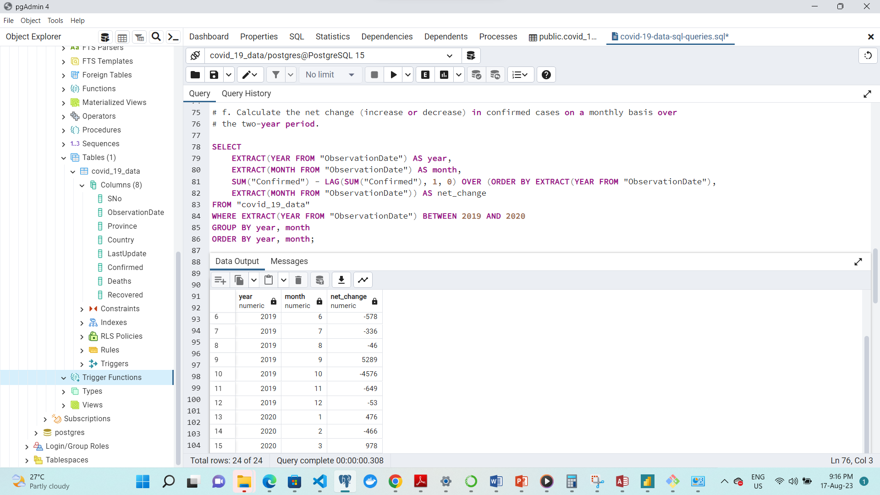

Slide 14
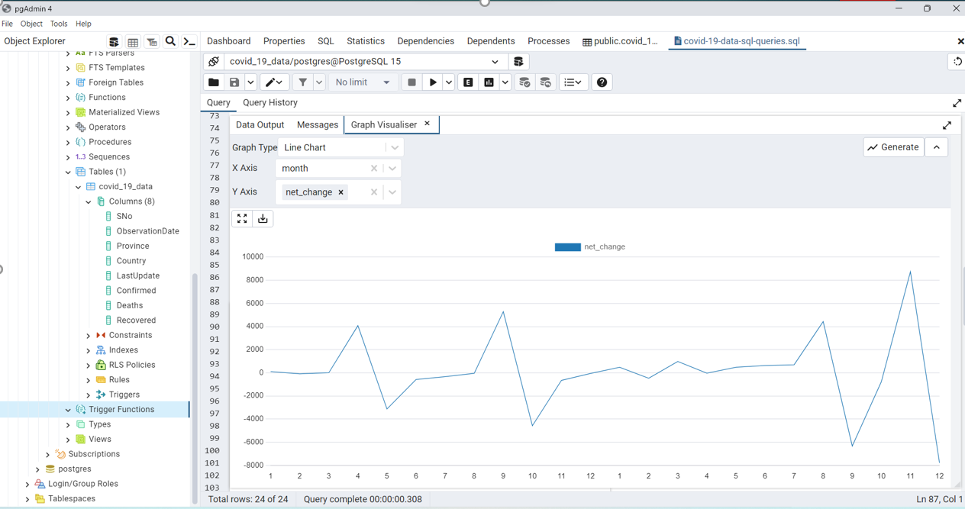

Slide 15
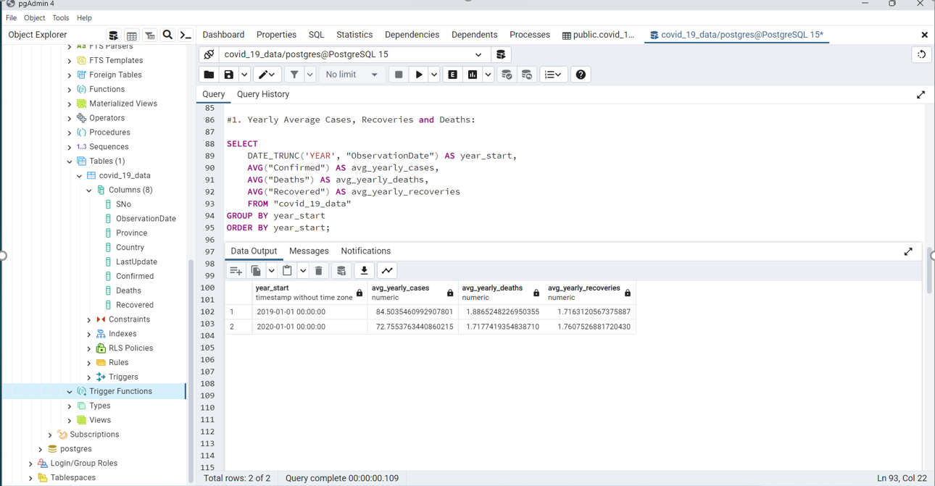

Slide 16
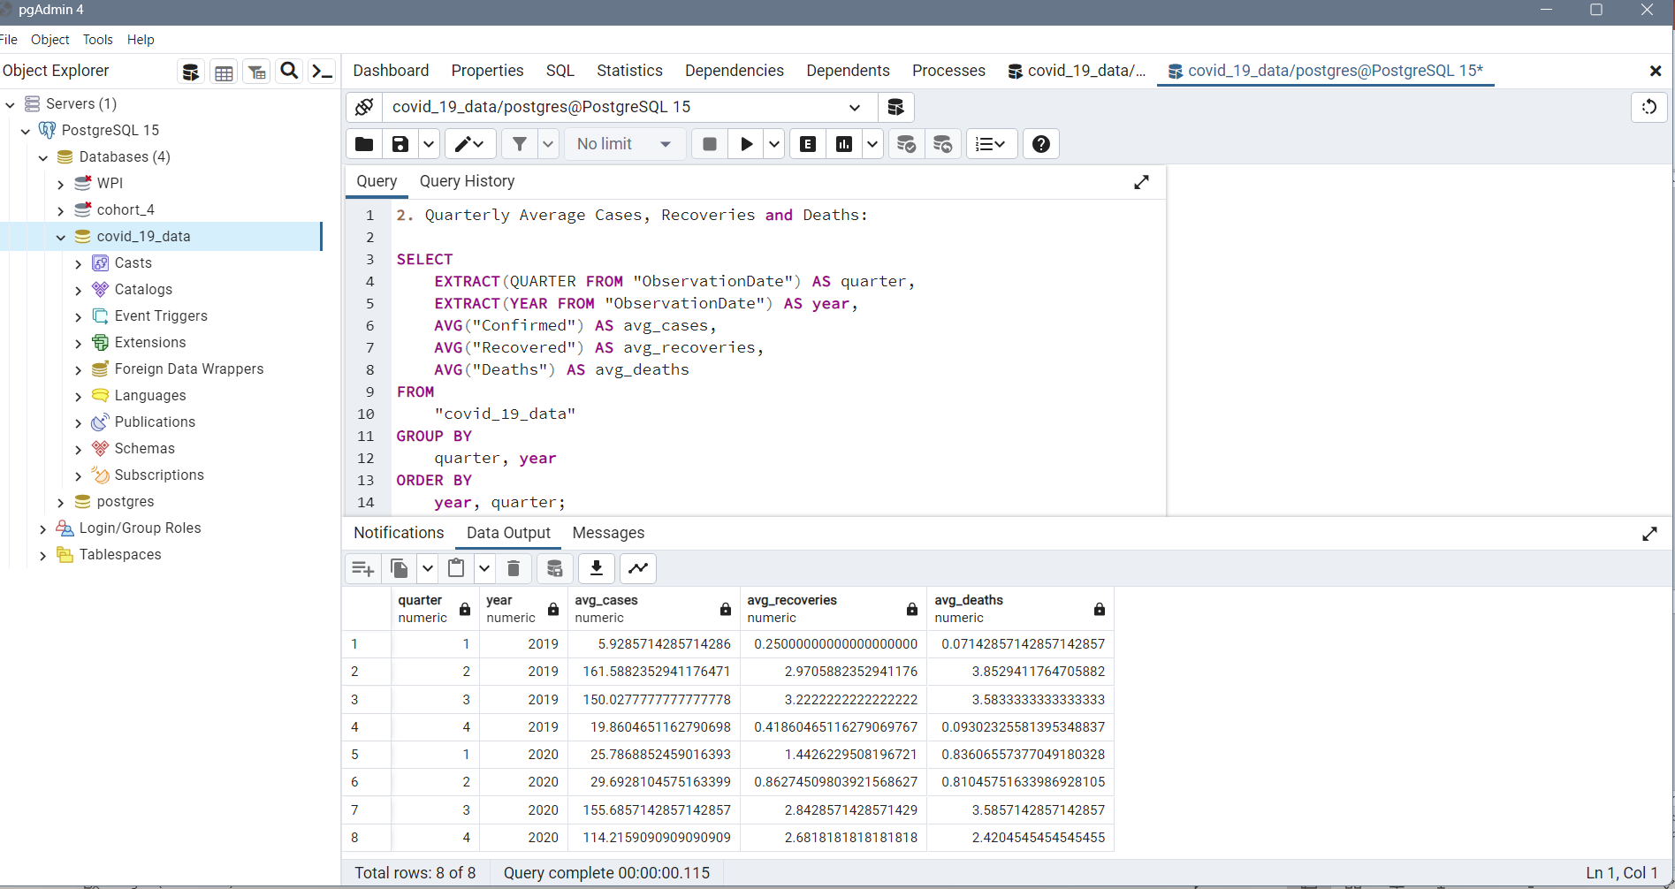

Slide 17
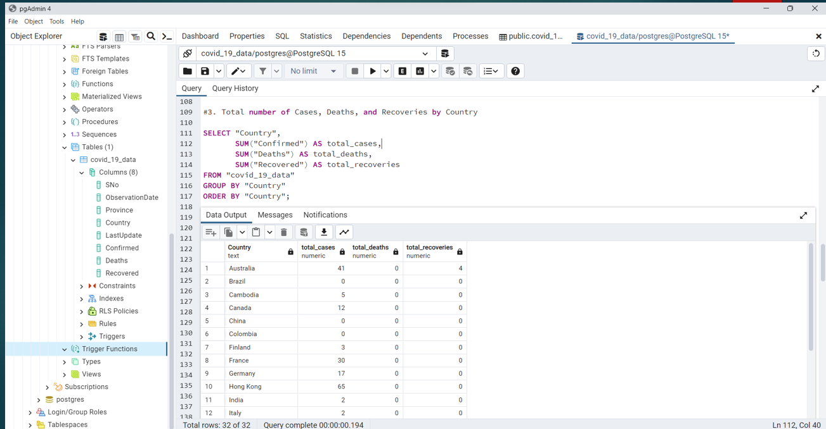

Slide 18
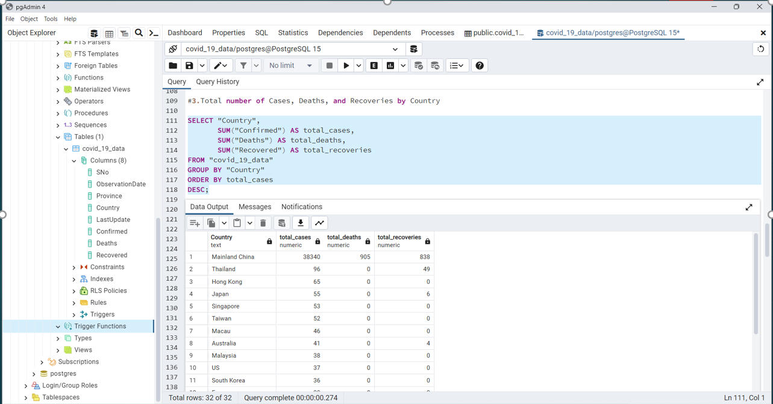

Slide 19
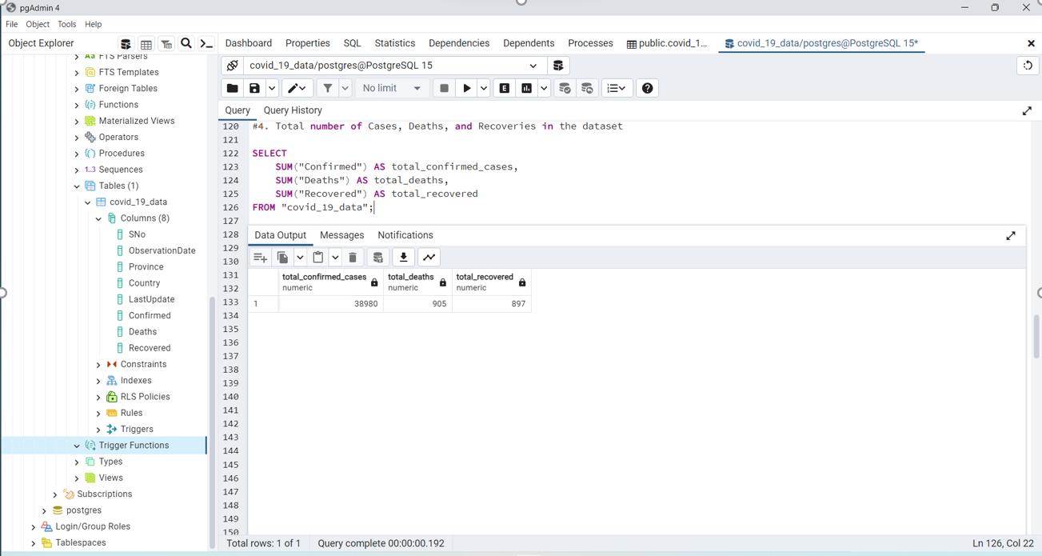

Slide 20
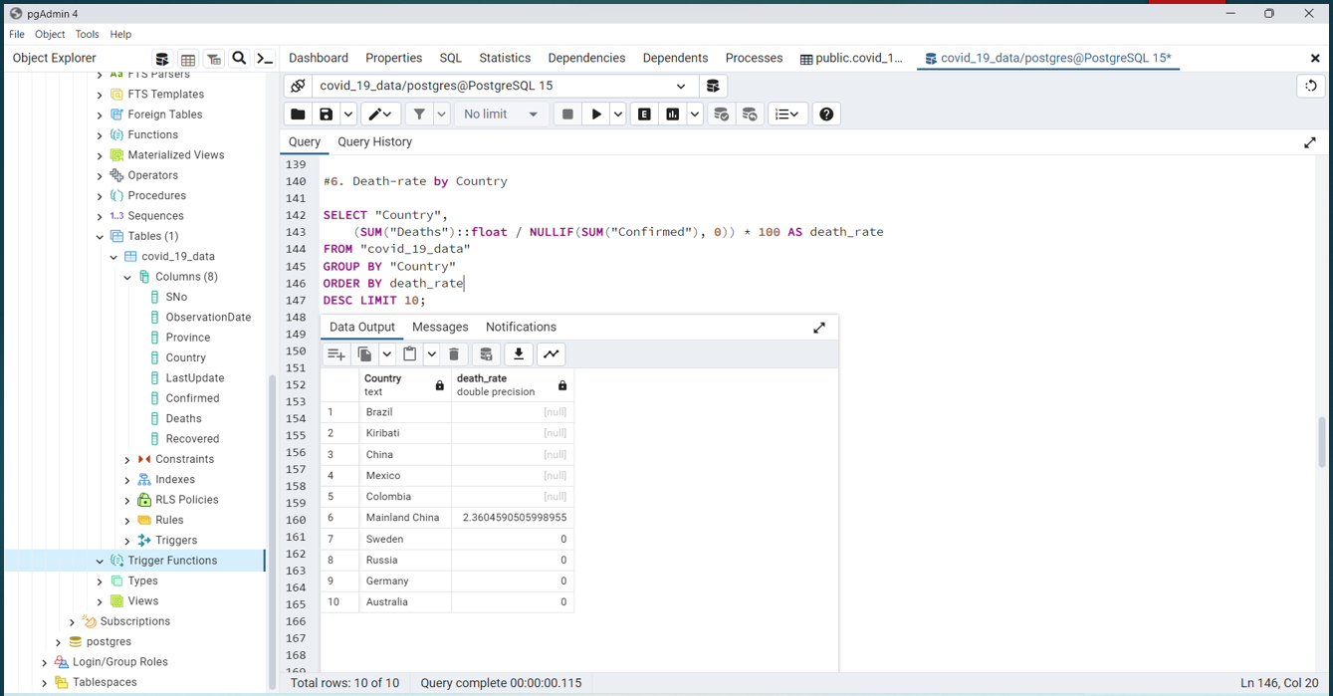

Slide 21
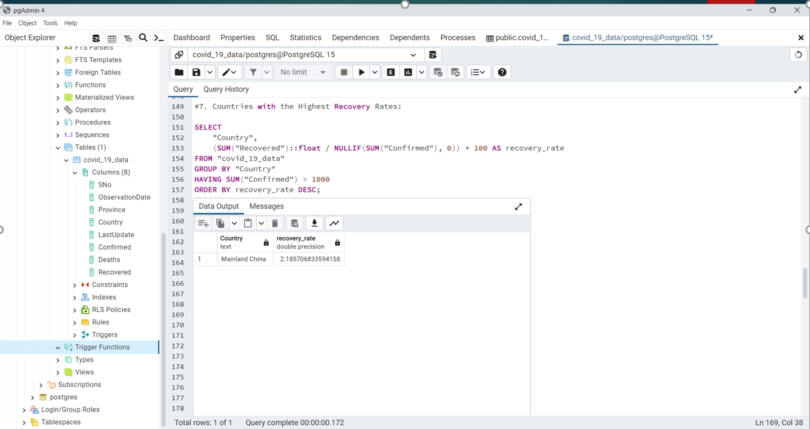

Slide 22
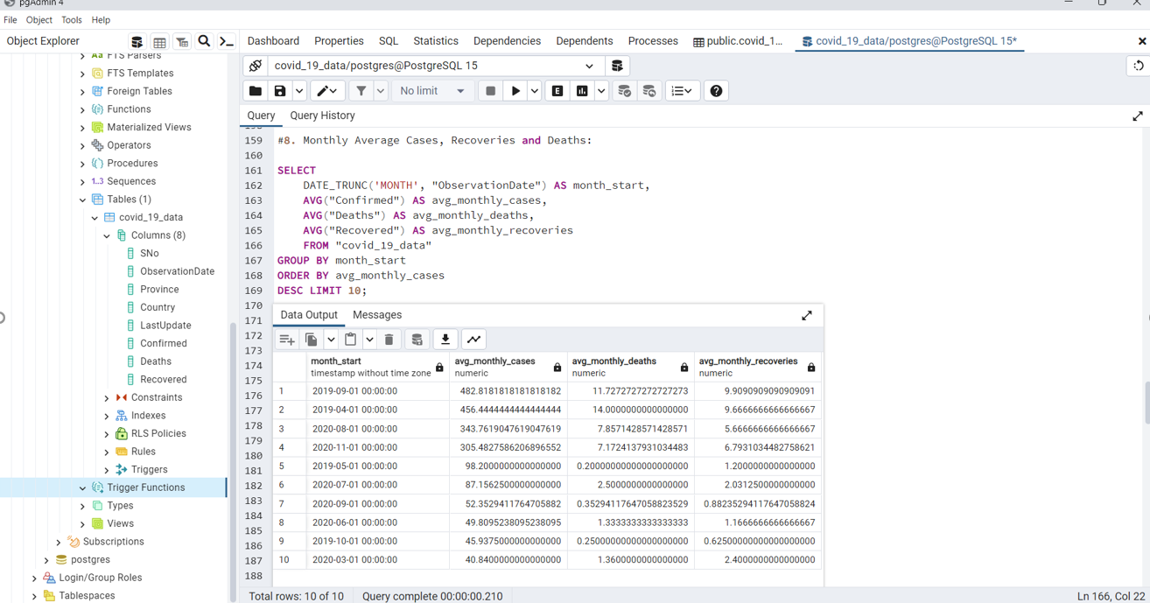

Slide 23
THANK YOU VERY MUCH !

